Slide 1
Proptosis
Dr. Dinesh Kumar Sharma MS (ENT), formerly Assistant Professor, GMC Amritsar

Slide 2
Definition
Proptosis refers to forward protrusion of the globe with respect to the orbit.
There are many causes of proptosis which can be divided according to location and it is worth remembering that it is not just orbital disease processes that cause proptosis.

Slide 3
Proptosis vs Exophthalmos
Exophthalmos also describes forward protrusion of the globe
Proptosis and exophthalmos are often used interchangeably
Exophthalmos used to refer to severe (>18 mm) proptosis
Exophthalmos used to refer to endocrine-related proptosis
Enophthalmos is the opposite, displacement of the globe posteriorly

Slide 4
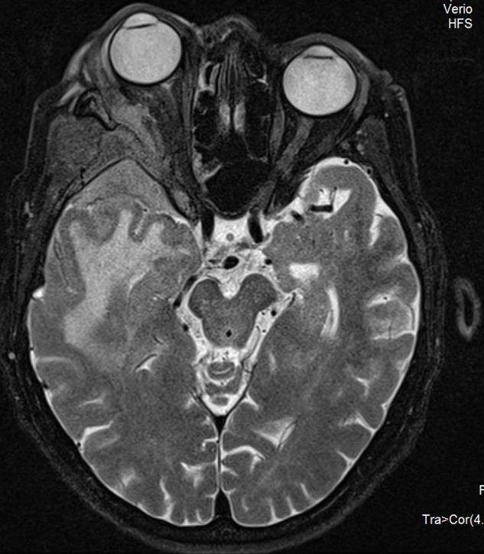
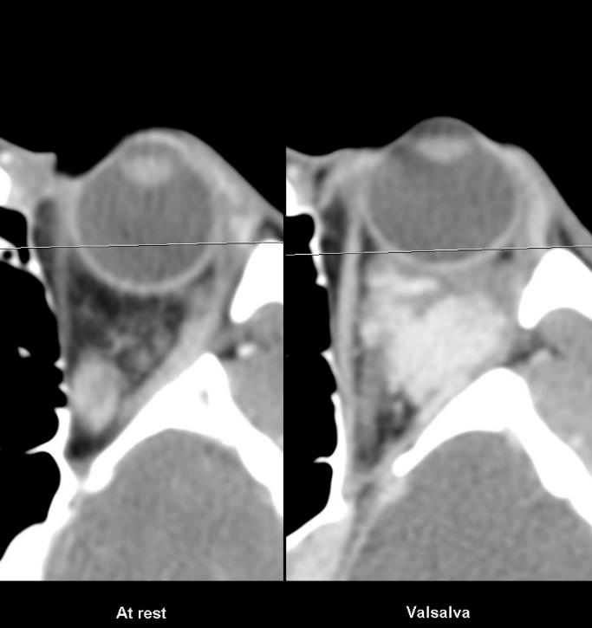
Proptosis

Slide 5
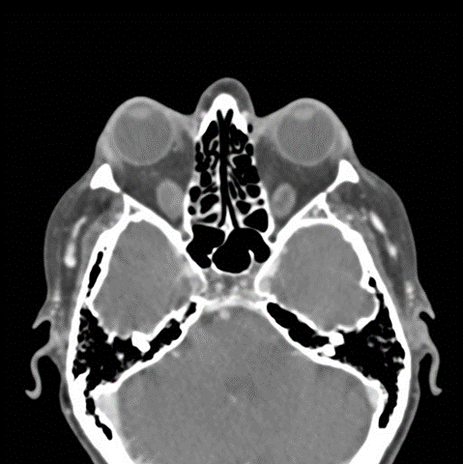
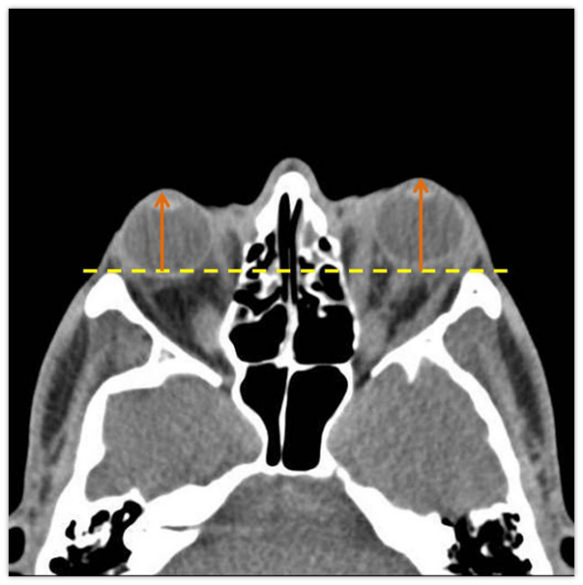
Thyrpoid Orbitopathy

Slide 6
Exorbitism
This is caused by a decrease in the volume of orbit causing the orbital contents to protrude forwards
Usually bilateral
Should be differentiated from proptosis / exophthalmos

Slide 7
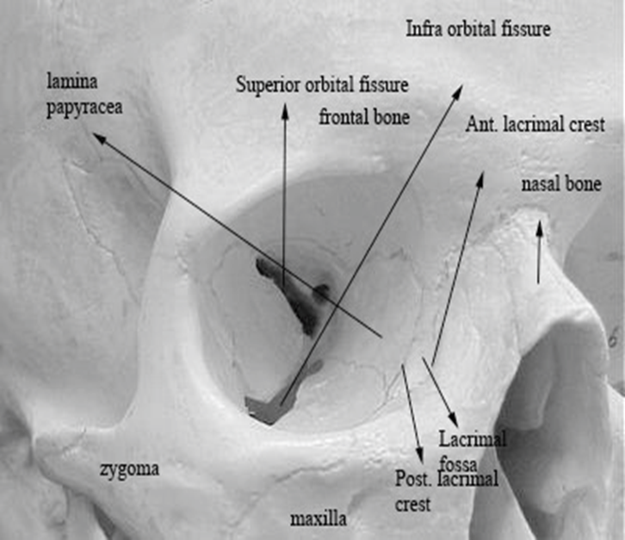
Anatomy of Orbit
Volume of orbit is fixed: 30 ml
Increase in soft tissue volume of 5 ml will cause 5 mm of proptosis

Slide 8
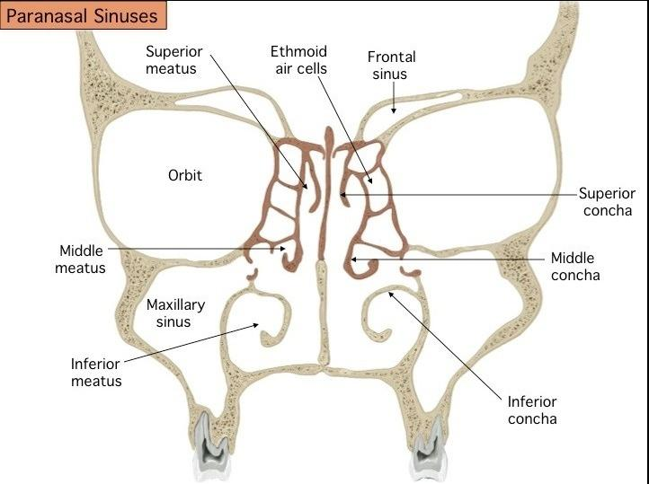
Orbit and PNS
Closely related:
  By location
  By venous drainage

Slide 9
Peculiarities of orbital venous drainage
Entire venous system is devoid of valves
Superior opthalmic vein connects facial vein to cavernous sinus – causing spread of infections from face to cavernous sinus
Inferior ophthalmic vein communicates with pterygoid venous plexus and cavernous sinus by its two branches

Slide 10
ETIOLOGY

Slide 11
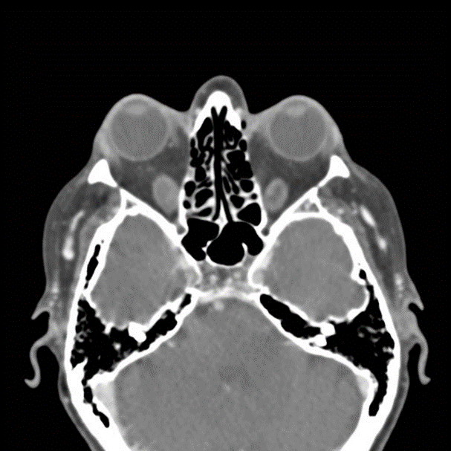
Thyroid Orbitopathy
Most common cause of uni/bilateral proptosis in adults
Exophthalmos is a condition of altered thyroid metabolism that causes protein depositions within the extraocular muscles
Eye involvement is bilateral in the majority of patients although 5% to 14% will have unilateral disease

Slide 12
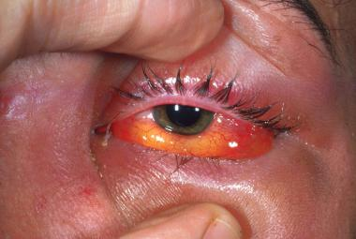
Infection
Orbital cellulitis
Orbital mucocoele
Sinusitis

Slide 13
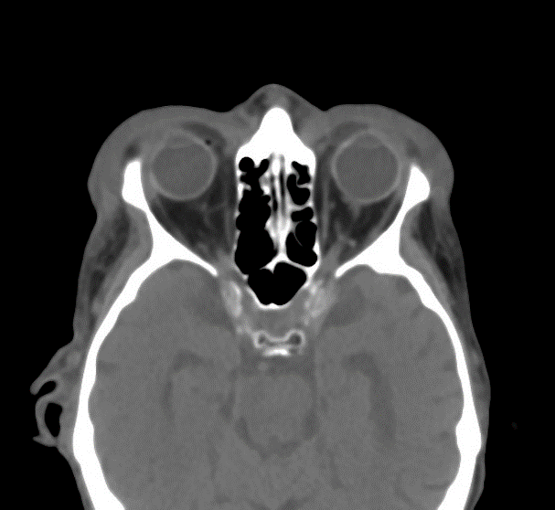
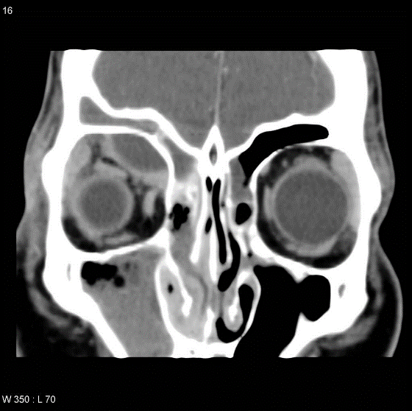
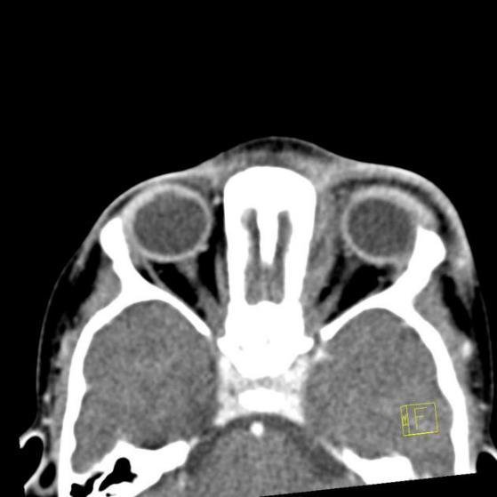
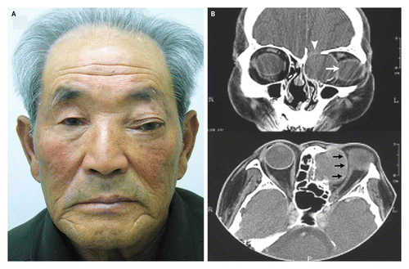
Pre-septal cellulitis
Sub-periosteal abscess
Pre-septal and Orbital cellulitis
Ethmoid mucocele

Slide 14
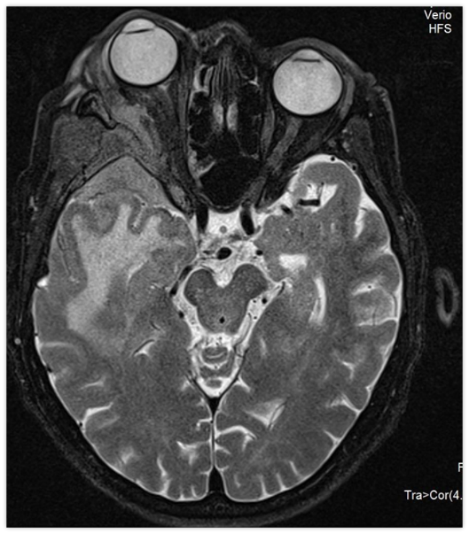
Tumours
Lymphoma, e.g. orbital lymphoma
Meningioma, e.g. sphenoid wing meningioma
Glioma
Orbital metastasis

Slide 15
Trauma,
Iatrogenic
Post-surgical

Slide 16

Vascular Lesions
Carotid-cavernous fistula
Capillary haemangioma
Cavernous haemangioma also known as orbital venous malformation
Orbital varix
AVM

Slide 17
VEIN
V – Vascular causes
E – Endocrine causes
I – Inflammatory causes
N – Neoplastic causes

Slide 18
Patient Evaluation
Full endocrinology work up is essential
Some patients complain of symptoms of Hyperthyroidism
Any patient with unilateral or bilateral exophthalmos should be considered to have thyroid disease

Slide 19
Radiology
CT scans of the orbit are essential if surgery is planned
Findings include 2 to 8 fold increase in the extraocular muscle bodies sparing the tendinous portions
Inferior and medial rectus muscles are most commonly involved

Slide 20
Radiology…..
Ultrasound can demonstrate thickening of all the extraocular muscles - used to monitor the response to therapy
T2 weighted images on MRI can show active inflammation in the orbit, no bony detail
Scans should include paranasal sinuses and rule out any significant sinus disease

Slide 21
Medical Management
All patients require management of their hyperthyroidism
Management usually centers on the suppression of the thyroid activity, after euthyroid status is achieved
for 6 months the orbital status usually stabilizes

Slide 22
Medical Management
1% to 2% of patient will develop a deterioration in the visual status and the treatment of choice is high dose steroids
Adjunctive treatment includes lubricants, artificial tears, moisture chambers, and taping retracted eyelids if necessary
Low dose radiation therapy has been used 20Gy in 10 fractions for 2 weeks - patients early in disease process most likely to benefit

Slide 23
Surgical Management
Usual functional indications for decompression are:
  Decreasing visual acuity, visual field defects.
  Abnormal visual-evoked potentials, and disc edema as well as corneal exposure with keratitis not responsive to medical management

Slide 24
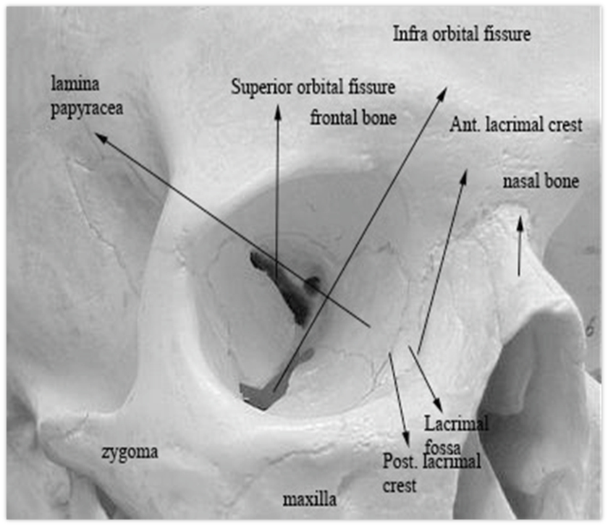
Surgical Approaches
Orbital Decompression:
  Superior
  Medial
  Inferior
  Lateral
  Intranasal
  Endoscopic

Slide 25
Complications
Progressive optic neuropathy which can lead to blindness
Steroid therapy complications - gastric ulcer, irritable personality, reactivation of dormant infection
Radiation complications - cataracts, pituitary suppression, and optic fibrosis

Slide 26
Refrences
Pictures on slide number 4, 5,11,13, 14, NS 16 are courtesy of Dr Mohammad Taghi Niknejad, <a href="https://radiopaedia.org/">Radiopaedia.org</a>. From the case <a href="https://radiopaedia.org/cases/20851">rID: 20851</a>
Proptosis, Dr Henry Knipe ◉ and Dr Ahmed Ali Abdel Hameed et al, https://radiopaedia.org/articles/proptosis-1
Proptosis, Balasubramanian Thiagarajan, Otolaryngology online
Other images have been downloaded from Google Images for teaching purposes and non-commercial use.

